Slide 1
Star Wars, Star Trek, and Harry Potter, Oh My! How we can use stories to help clients recover from PTSD
Janina Scarlet, Ph.D.
Superhero Therapy
Chase Masterson
Pop Culture Hero Coalition

Slide 2
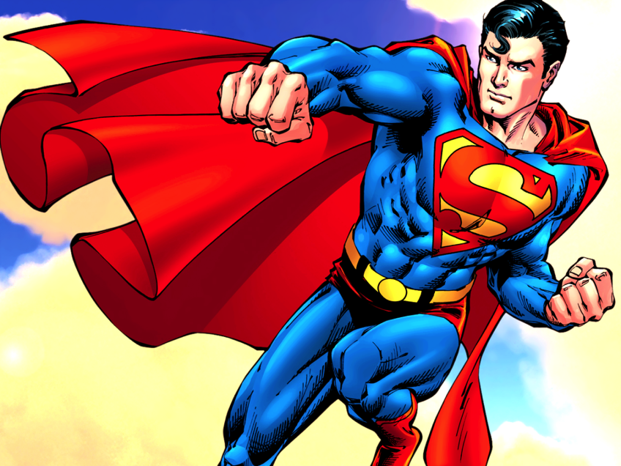
Superman: Clinical Application
“I wanted to be Superman… I failed”

Slide 3
Superman: Clinical Application
“I wanted to be Superman, I failed”
Invincible

Slide 4
Superman: Clinical Application
“I wanted to be Superman, I failed”
Invincible
Kryptonite

Slide 5
What is Superhero Therapy?
Using stories from popular culture (books, TV shows, movies, and video games examples) in evidence-based therapies (CBT, ACT, prosocial research)
To help client become
a version of a hero
IRL
For people of all ages
No need to be the expert

Slide 6
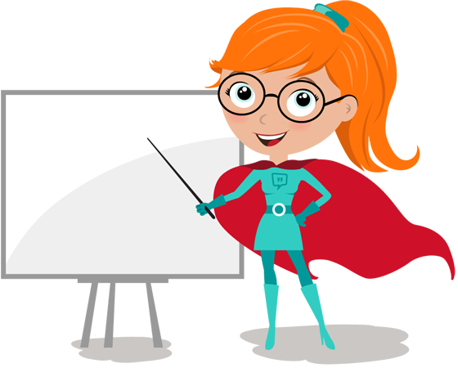
Most important rule of Superhero Therapy
You don’t have to be the expert
The client is the expert
The only requirement:
Open-minded
Curious

Slide 7
PTSD as an origin story

Slide 8
Origin Stories

Slide 9
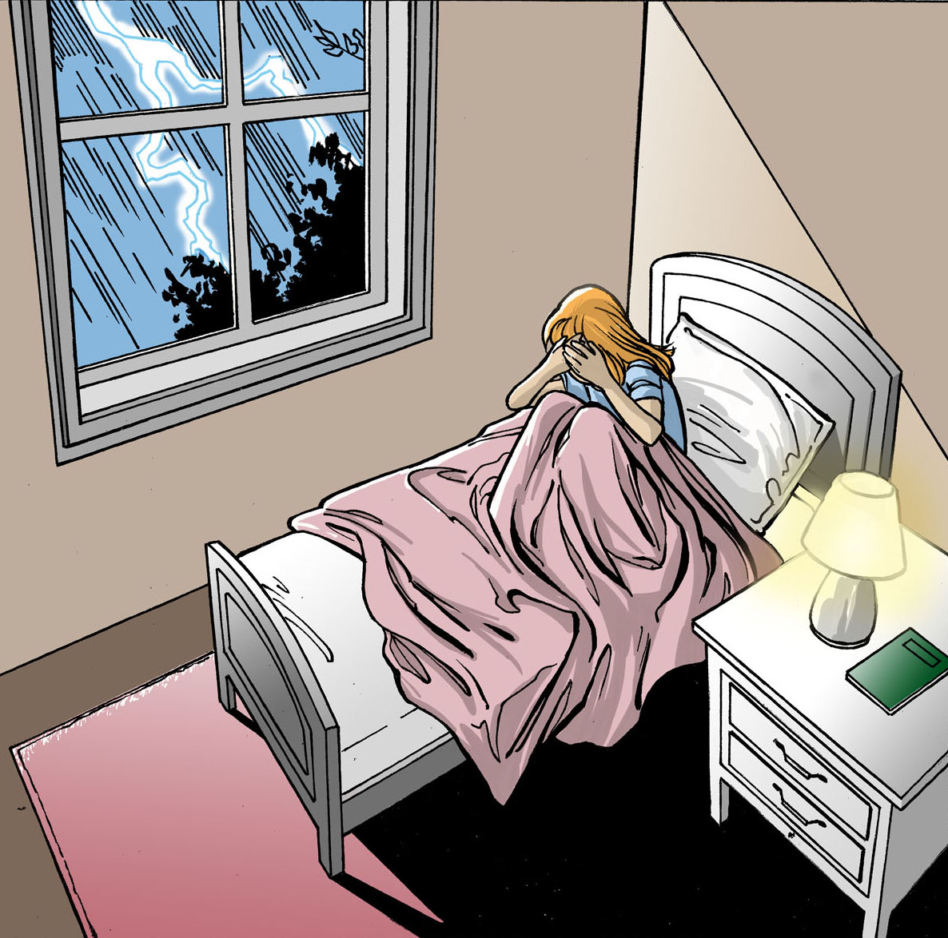

Slide 10
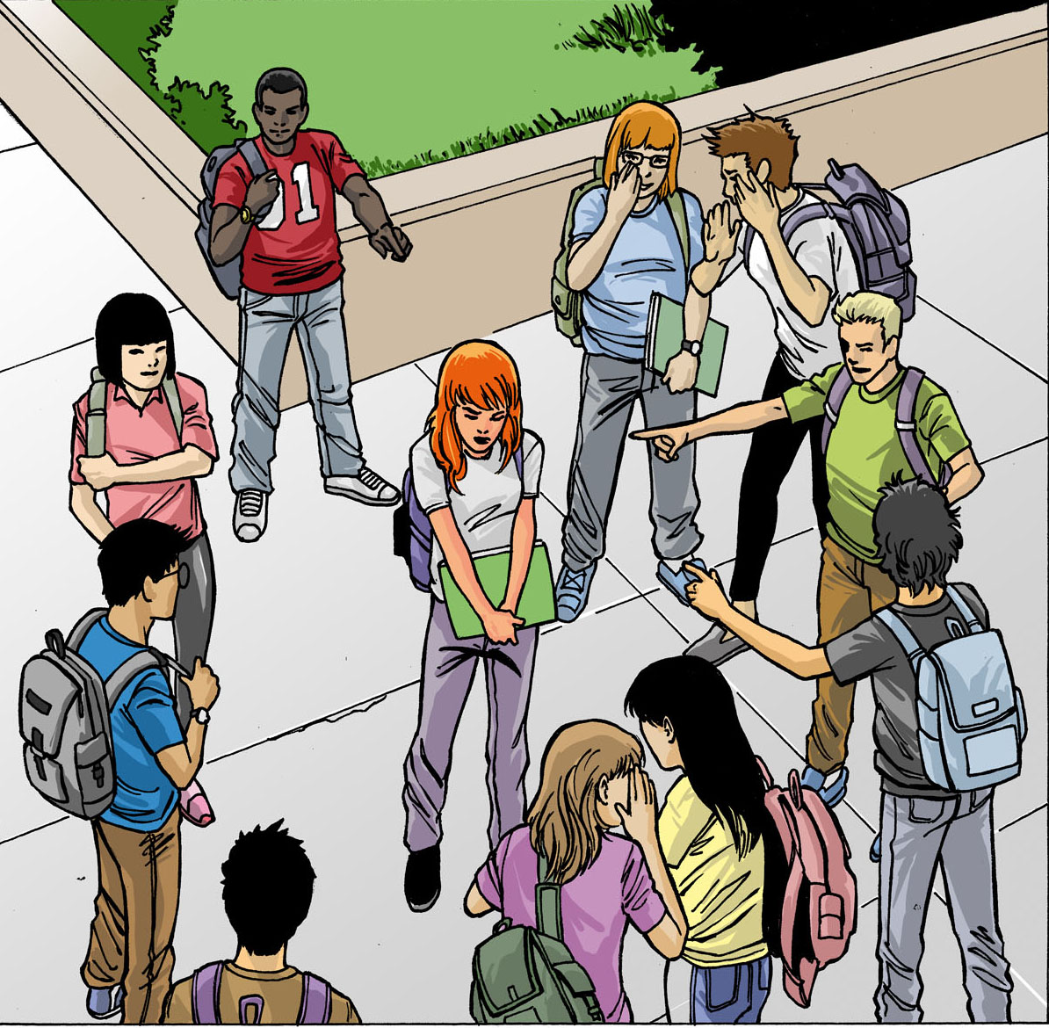
Abuse, Assault, and Bullying

Slide 11
PTSD

Slide 12
Notes:
The X-Men are a group of mutants that all have some special abilities, like being able to walk through walls or read people’s minds or having superstrength. Sounds pretty cool, right? Well, not many of them felt that way.

Slide 13
Post-Traumatic Growth

Slide 14
Why Superhero Therapy?
During most difficult times, people feel alone
Especially when facing PTSD

Slide 15
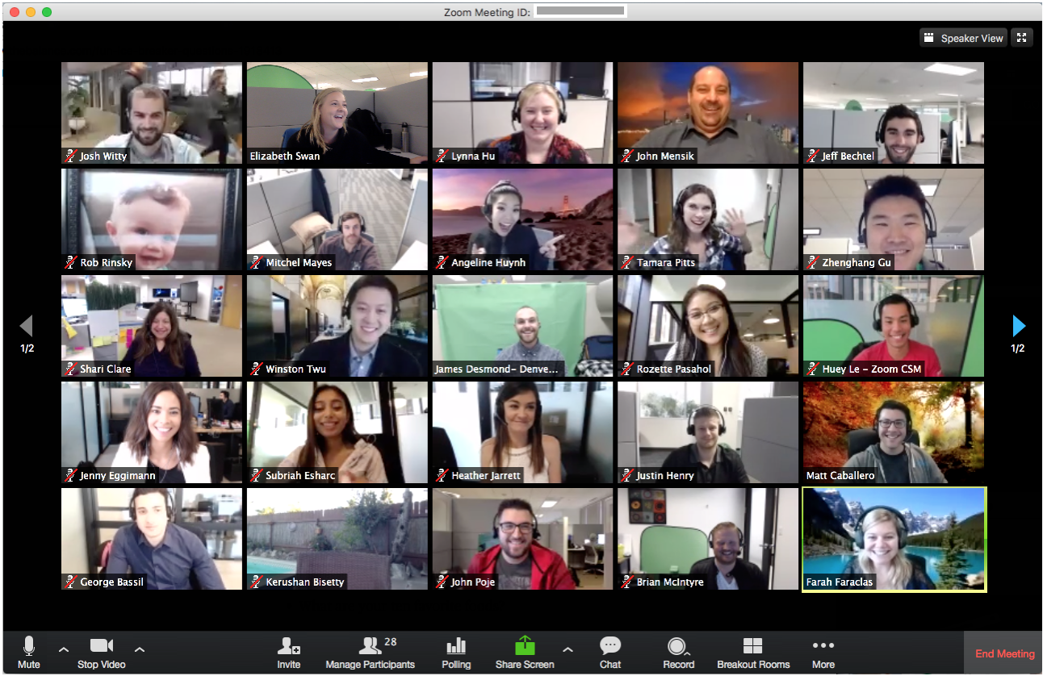
The pain of disconnection
Sometimes worse in social situations
Incongruency = Disconnection = SHAME

Slide 16
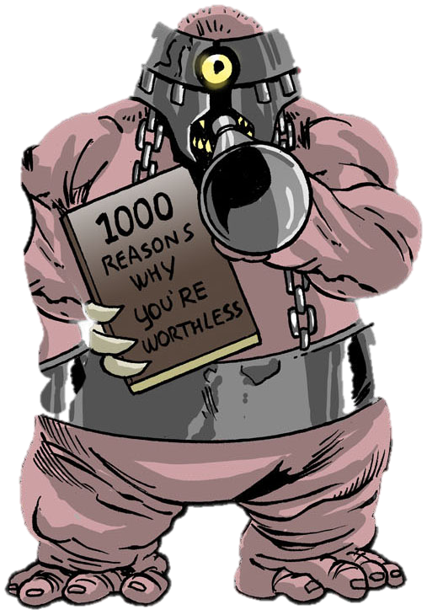
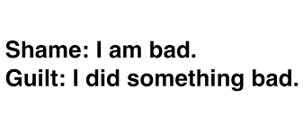

Slide 17
Brene Brown’s Research
“We deny our loneliness. We feel shame around being lonely even when it’s caused by grief, loss, or heartbreak”
Brené Brown
The less we talk about it, the more we feel it

Slide 18
Potential Triggers for Shame Experiences of Not Fitting In related to:
Appearance
Body Image
Money
Mental health
Physical health
Addiction
Homelessness
Sexual orientation
Gender identity
Religion/Cultural identity
Surviving/experiencing trauma
Race/ethnicity
Divorce
Incarceration

Slide 19
How shame shows up in mental health

Slide 20
COVID-19 -> Universal grief & Empathic distress

Slide 21
Empathic Distress
Suffering because others are suffering
Emotional burnout
The need for self-compassion
(Klimecki & Singer, 2012).

Slide 22
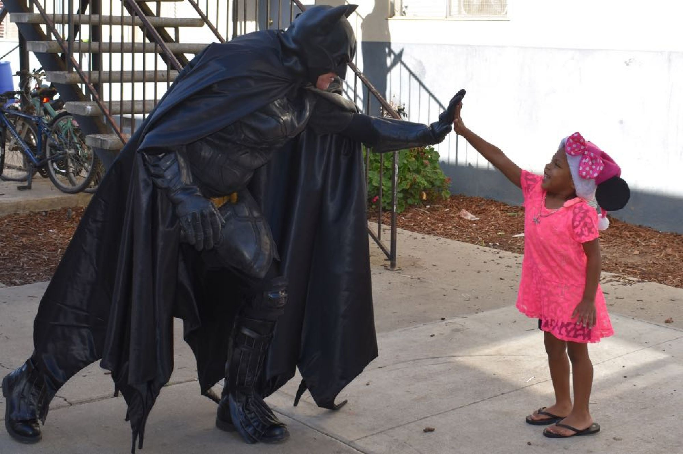
Social Connection
Creates common humanity – we are not alone
Destigmatizes the experience
Promotes hope
“It’s not that misery loves company, it’s that company is the antidote to misery”
- Kristin Neff

Slide 23
Parasocial Relationships (PSRs)
Serve as Social Surrogates
Friend
Family member
Support group

Slide 24
PSRs: Reduced Loneliness/Rejection Feelings
When lonely, participants watched favorite TV show (eg FRIENDS) rather than “whatever was on TV”
Not escapism, but a need for connection
Watching favorite TV show allowed for participants to feel significantly less lonely
Derrick, J. E., Gabriel, S., & Hugenberg, K. (2009).

Slide 25
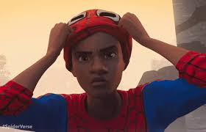
Superhero Priming
Superhero priming (e.g through pretending to be one or playing VR game) increases helping Bx (eg in pencil drop)
Rosenberg et al (2013)
Superhero poses can increase helping Bx (Peña & Chen, 2017) & self-esteem (Cuddy et al, 2015)

Slide 26
Superhero Priming: Healthier Food Choices
Cornell University
Children were asked to pick between apples and French fries
Only 9% chose apples
When primed with admirable heroes, like Batman, nearly 50% chose apples
*Dressing up also helps maintain attention on task
Wansink et al. (2012)
White & Carlson (2015)

Slide 27
Research: HP Boosts Compassion
Notes:
HP: story of wizard boy… some wizards aren’t so nice, like Draco Malfoy here, who is calling another student a Mudblood, which means “dirty blood.” This is a derogatory word toward witches and wizards born to non-magical parents and is meant as a painful insult

Slide 28
Research: HP Boosts Compassion
Notes:
Vezzali et al 2014: **RTC**: researchers asked high school children to read passages from Harry Potter, either related or unrelated to prejudice, those that read the passages related to prejudice demonstrated more compassionate attitude twd stigmatized groups (LGBT, immigrants)

Slide 29
Exposure Therapy – Specific Phobia Showing Spider-Man videos reduces phobia
Hoffman, Y. S., Pitcho-Prelorentzos, S., Ring, L., & Ben-Ezra, M. (2019)

Slide 30
Exposure Therapy
Hoffman, Y. S., Pitcho-Prelorentzos, S., Ring, L., & Ben-Ezra, M. (2019)

Slide 31
PTSD
Undergraduate students who were exposed to trauma
Stronger connection to PSRs than classmates
Gabriel, et al. (2017).

Slide 32
Sexual assault awareness for children
Marvel and National Committee for Prevention of Child Abuse (NCPCA)( 1984 and 1985 )
Spider-Man discovers that a little boy was sexually abused by his babysitter
Spider-Man shares with him his own story of being sexually abused by a young man
Boy is later able to report the incident to his parents with Spider-Man’s help
Notes:
In 1984 and 1985 Marvel released two comics about Spider-Man, commissioned by the National Committee for Prevention of Child Abuse (NCPCA), who discovers that a little boy was sexually abused by his teenage babysitter and shares with him his own story of being sexually abused by a young man he became friends with. He is later able to tell his aunt and uncle about this. The boy is later able to report the incident to his parents with Spider-Man’s help. In another story, a little girl runs away because she was sexually abused by her father and her mother refuses to believe her. The girl later becomes a part of the Power Pack Kids in the later Power Pack Kids comics. In late 1980s over 16 million copies were distributed throughout the US.
In a research study, 73 children from grades 2-6 were shown the comic. Most reported being anxious afterward, realizing that it could happen to them too. One of the boys reported that the comics depicted exactly what he experienced in terms of being molested by a teenage neighbor. The boy reported that having had the comic earlier would have helped him understand that he had the right to tell his mother about the abuse and would have given him the courage to do so.

Slide 33
Sexual assault awareness for children
In a research study, 73 children from grades 2-6 were shown the comic. One of the boys reported that the comics depicted exactly what he experienced in terms of being molested by a teenage neighbor. The boy reported that having had the comic earlier would have helped him understand that he had the right to tell his mother about the abuse and would have given him the courage to do so.
Garbarino, J. (1987).
Notes:
In 1984 and 1985 Marvel released two comics about Spider-Man, commissioned by the National Committee for Prevention of Child Abuse (NCPCA), who discovers that a little boy was sexually abused by his teenage babysitter and shares with him his own story of being sexually abused by a young man he became friends with. He is later able to tell his aunt and uncle about this. The boy is later able to report the incident to his parents with Spider-Man’s help. In another story, a little girl runs away because she was sexually abused by her father and her mother refuses to believe her. The girl later becomes a part of the Power Pack Kids in the later Power Pack Kids comics. In late 1980s over 16 million copies were distributed throughout the US.
In a research study, 73 children from grades 2-6 were shown the comic. Most reported being anxious afterward, realizing that it could happen to them too. One of the boys reported that the comics depicted exactly what he experienced in terms of being molested by a teenage neighbor. The boy reported that having had the comic earlier would have helped him understand that he had the right to tell his mother about the abuse and would have given him the courage to do so.

Slide 34
PTSD Rates
Spiking now
Will likely continue to spike during and after the pandemic
International mental health crisis

Slide 35
Superhero Therapy
Need to help clients in ways to make therapy non-threatening and approachable
Using the client’s culture and passions as a strength and core values
Using stories like Harry Potter, Star Wars, Avengers, etc. as a way to motivate change inspire hope

Slide 36
PTSD and Shame
PTSD -> Shame
Shame -> Experiential avoidance
Experiential avoidance -> prolonged/worsened symptoms
Thompson & Waltz (2008)

Slide 37
PTSD and Common Humanity
Common Humanity -> we are not alone
Reduces Shame
Thompson & Waltz (2008)

Slide 38
Superhero Therapy elicits common humanity and can reduce shame
Can reduce shame by pointing out that even superheroes have vulnerabilities
Seeing how fictional characters process grief, loss, and other mental health struggles

Slide 39
Superhero Therapy Model, how it relates to stories and Treatment
Origin Story
Finding a hero role model
Skills & training
Defining purpose
Becoming a Superhero IRL
Monsters
Setbacks & hopelessmess

Slide 40
Buffy the Vampire Slayer

Slide 41
What if I like a villain?
Joker
Harley Quinn
Dexter
Darth Vader
Voldemort

Slide 42
Villain example: Kylo Ren (Star Wars)

Slide 43
Superhero Therapy Model
Origin Story
Finding a hero role model
Skills & training
Defining purpose
Becoming a Superhero IRL
Monsters
Setbacks & hopelessmess

Slide 44
Defining One’s Own Superhero Origin Story
Telling and retelling our
“origin story” can reduce PTSD symptoms

Slide 45
Scripting One’s Own Origin Story
Not necessarily the biggest event
Can also be “death by a thousand cuts”
Abandonment
Rejection
Prejudice
Being made to feel “not enough”

Slide 46
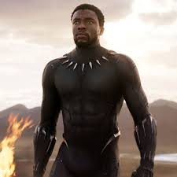
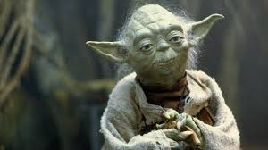
Who is Your (Super)Hero ?
Can be real life or fictional
Someone who is a figure of great strength and wisdom
What do you admire about them ?

Slide 47
Your Hero’s Message

Slide 48
Identifying “monsters”
“Monsters” are any unwanted feelings, emotions, sensations, and thoughts that the client may want to get rid of
“Monsters” are not perpetrators of abuse, they are the result of it

Slide 49
Willingness to face emotions
Experiential
Avoidance
doesn’t work
The only way out is through

Slide 50
Can help clients to find their own core values and inspire committed actions

Slide 51
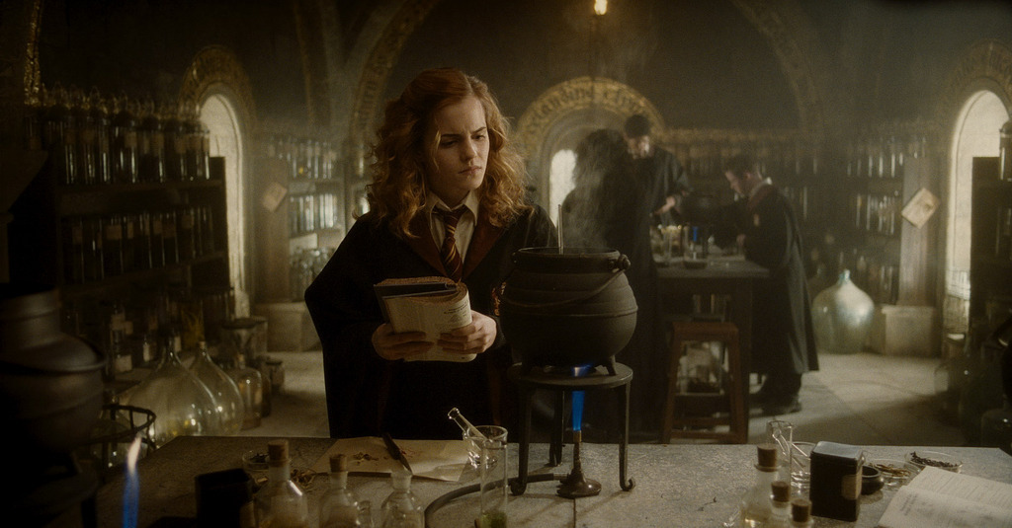
Identifying core values
Imagine that you could be a real life superhero

Slide 52
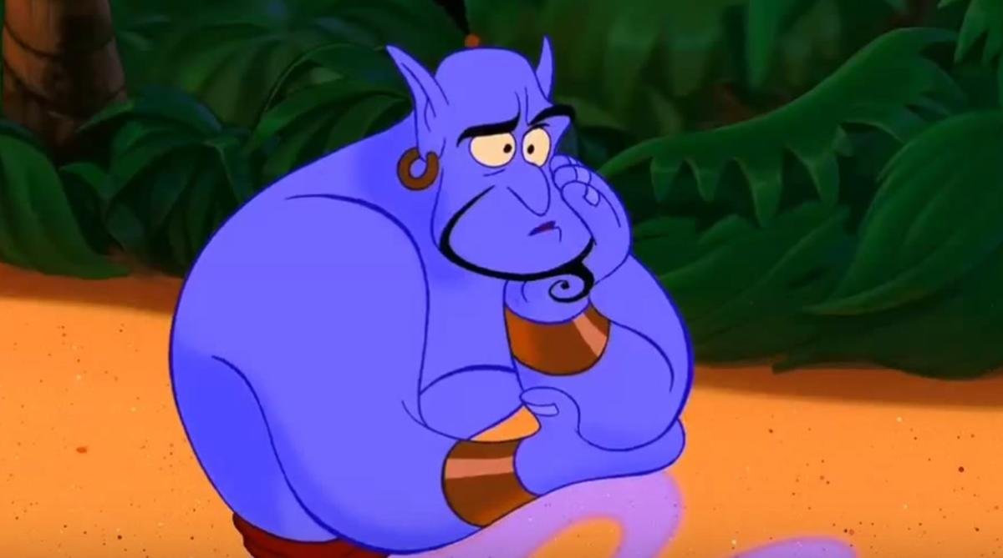
Identifying core values
If you could be granted a superpowers or a magical ability, what would you wish for?

Slide 53
Identifying core values
What would you do with these abilities?

Slide 54
The bigger picture
It’s not about what you DO
It’s about what do FOR THE WORLD
External focus
Posttraumatic growth and meaning making
(Park & Ai, 2006).

Slide 55
Veronica Mars

Slide 56
What would Veronica do?

Slide 57
Remember
YOU are the Chosen One
It has to be YOU
YOU make a difference

Slide 58
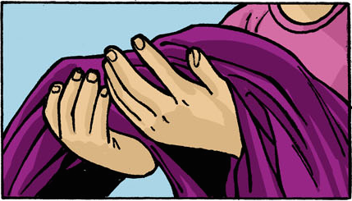
This is YOUR Heroic Journey too
YOU make a difference every day
Keep Superheroing and don’t forget your cape

Slide 59
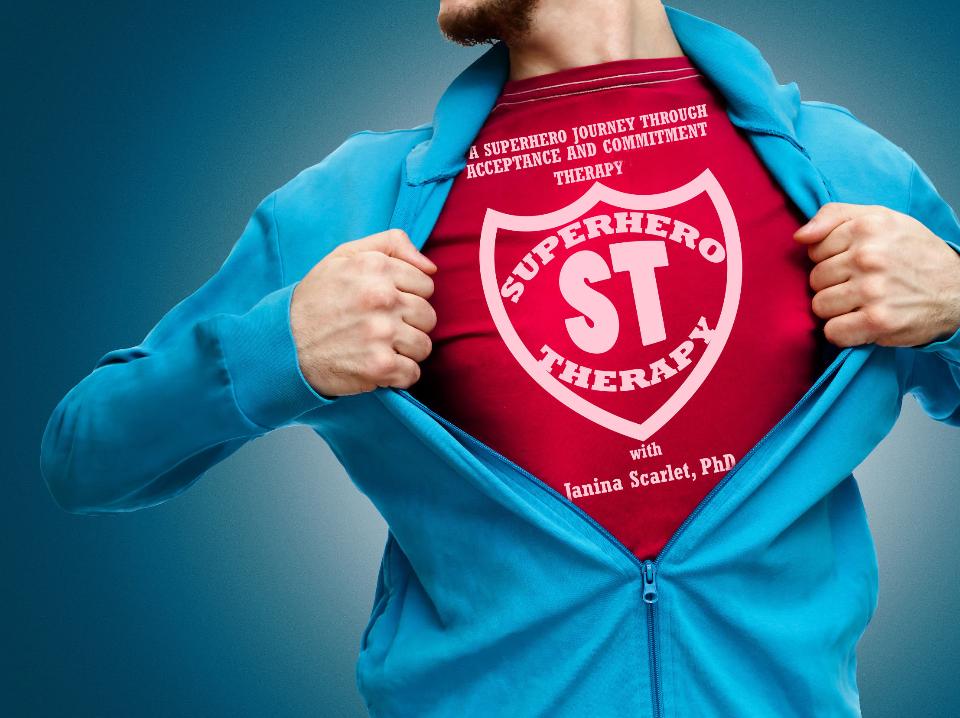
References
Cuddy, A. J., Wilmuth, C. A., & Carney, D. R. (2012). The benefit of power posing before a high-stakes social evaluation. Harvard Business School Working Paper, No. 13-027, http://nrs.harvard.edu/urn-3:HUL.InstRepos:9547823
Derrick, J. E., Gabriel, S., & Hugenberg, K. (2009). Social surrogacy: How favored television programs provide the experience of belonging. Journal of Experimental Social Psychology 45, 352–362
Gabriel, S., Read, J. P., Young, A. F., Bachrach, R. L., & Troisi, J. D. (2017). Social surrogate use in those exposed to trauma: I get by with a little help from my (fictional) friends. Journal of social and clinical psychology, 36(1), 41-63.
Garbarino, J. (1987). Children's response to a sexual abuse prevention program: A study of the Spiderman comic. Child Abuse and Neglect, 11(1), 143-148.
Hoffman, Y. S., Pitcho-Prelorentzos, S., Ring, L., & Ben-Ezra, M. (2019). “Spidey Can”: Preliminary Evidence Showing Arachnophobia Symptom Reduction Due to Superhero Movie Exposure. Frontiers in psychiatry, 10.
Klimecki, O., & Singer, T. (2012). Empathic distress fatigue rather than compassion fatigue? Integrating findings from empathy research in psychology and social neuroscience. Pathological Altruism, 368-383.

Slide 60
References
Park, C. L., & Ai, A. L. (2006). Meaning making and growth: New directions for research on survivors of trauma. Journal of Loss and Trauma, 11(5), 389-407.
Peña, J., & Chen, M. (2017). With great power comes great responsibility: Superhero primes and expansive poses influence prosocial behavior after a motion-controlled game task. Computers in Human Behavior, 76, 378-385.
Rosenberg, R.S., Baughman, S.L., Bailenson, J.N., (2013). Virtual superheroes: Using superpowers in virtual reality to encourage prosocial behavior. PLoS ONE 8 (1), e55003.
Thompson, B. L., & Waltz, J. (2008). Self‐compassion and PTSD symptom severity. Journal of Traumatic Stress: Official Publication of The International Society for Traumatic Stress Studies, 21(6), 556-558.
Vezzali, L., Stathi, S., Giovannini, D., Capozza, D., & Trifiletti, E. (2015). The greatest magic of Harry Potter: Reducing prejudice. Journal of Applied Social Psychology, 45(2), 105-121.
Wansink, B., Shimizu, M., & Camps, G. (2012). What would Batman eat?: Priming children to make healthier fast food choices. Pediatric Obesity, 7(2), 121-123.
White, R. E., & Carlson, S. M. (2015). What would Batman do? Self‐distancing improves executive function in young children. Developmental Science, 19 (3), 419-426.

